Slide 1
Primal Simplex Method

Slide 2







Example Problem
Consider the example LP model developed for a pencil production problem
$$\max{z=0.38x_{e}+0.76x_{d}}$$
(Profit Contribution)
$$s.t.$$
$$2x_{e}+2x_{d}≤43,200$$
(Preprocessing)
$$3.5x_{e}+3.5x_{d}≤29,700$$
(Curing)
$$1.25x_{e}+8.75x_{d}≤46,800$$
(Shaping)
$$8x_{e}+10x_{d}≤64,800$$
(Assembly)
$$x_{e}, x_{d}≥0$$

Slide 3
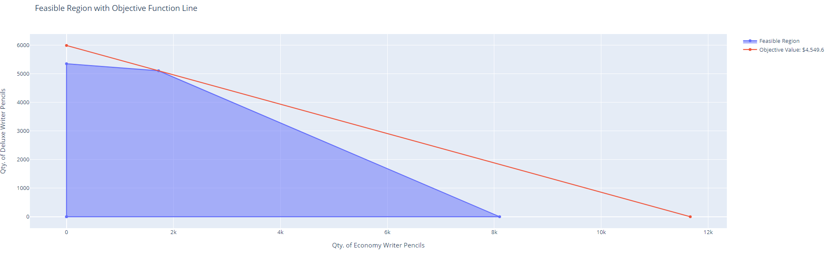
Graphical Solution
With only 2 decision variables the problem can be solved using a graphical approach
(0, 5348.6)
(1721.7, 5102.6)
(0, 0)
(8100, 0)

Slide 4
Primal Simplex Method Steps
Step 0: Convert the LP model to standard form
Nonnegative right-hand side values
Construct table for performing method computations – select initial feasible basic solution
Step 1: Select the entering variable from among the current nonbasic variables using the optimality condition
Step 2: Select the leaving variable from among the current basic variables using the feasibility condition
Step 3: Determine the values of the new basic variables by making the entering variable basic and the leaving variable nonbasic. Return to step 1.
Implement Gauss-Jordan method

Slide 5







Example Problem – Standard Form
Resulting standard form of the model
Standard Form Conditions
All constraints are equations
Include slack & surplus variables
All variables are nonnegative
Objective function is max. or min.
$$\max{z=0.38x_{e}+0.76x_{d}}$$
(Profit Contribution)
$$s.t.$$
$$2x_{e}+2x_{d}+s_{1}=43,200$$
(Preprocessing)
$$3.5x_{e}+3.5x_{d}+s_{2}=29,700$$
(Curing)
$$1.25x_{e}+8.75x_{d}+s_{3}=46,800$$
(Shaping)
$$8x_{e}+10x_{d}+s_{4}=64,800$$
(Assembly)
$$x_{e}, x_{d}, s_{1}, s_{2}, s_{3}, s_{4} ≥0$$

Slide 6
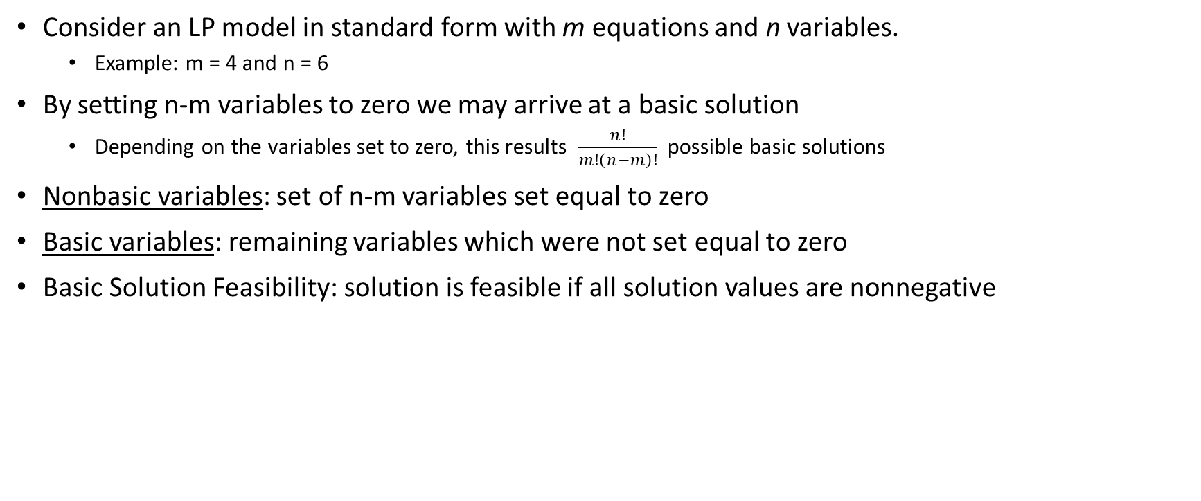
Math Preliminary –Basic Solutions
Consider an LP model in standard form with m equations and n variables.
Example: m = 4 and n = 6
By setting n-m variables to zero we may arrive at a basic solution
Depending on the variables set to zero, this results $\frac{n!}{m!\left(n−m\right)!}$ possible basic solutions
Nonbasic variables: set of n-m variables set equal to zero
Basic variables: remaining variables which were not set equal to zero
Basic Solution Feasibility: solution is feasible if all solution values are nonnegative

Slide 7

Example Problem in Initial Tabular Form
Consider the objective function to be written as:
The table can be written as shown below for the initial basic solution:
$$z−0.38x_{e}−0.76x_{d}=0$$
Objective Function
Decision & Slack Variables
Basic | z | x_{e} | x_{d} | s₁ | s₂ | s₃ | s₄ | Solution
z | 1 | -0.39 | -0.76 | 0 | 0 | 0 | 0 | -
s₁ | 0 | 2 | 2 | 1 | 0 | 0 | 0 | 43,200
s₂ | 0 | 3.5 | 3.5 | 0 | 1 | 0 | 0 | 29,700
s₃ | 0 | 1.25 | 8.75 | 0 | 0 | 1 | 0 | 46,800
s₄ | 0 | 8 | 10 | 0 | 0 | 0 | 1 | 64,800
Objective Function
Basic
Variables
RHS Values
Coefficients

Slide 8
Optimality & Feasibility Conditions
Optimality Condition
“The entering variable in maximization (minimization) is the nonbasic variable with the most negative (positive) coefficient in the objective z-equation. A tie may be broken arbitrarily. The optimum is reached when all the nonbasic coefficients in the z-equation are nonnegative (nonpositive).”
Feasibility Condition
“For both maximization and minimization problems, the leaving variable is the current basic variable having the smallest intercept (minimum ratio with strictly positive denominator) in the direction of the entering variable. A tie is broken arbitrarily.”

Slide 9
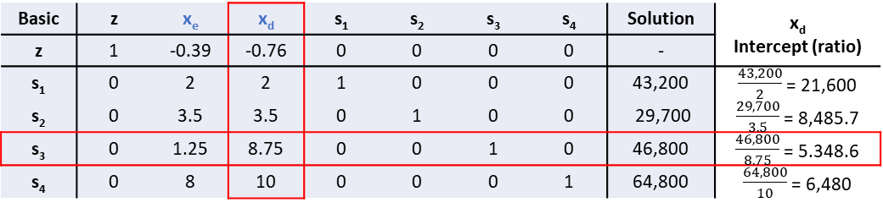
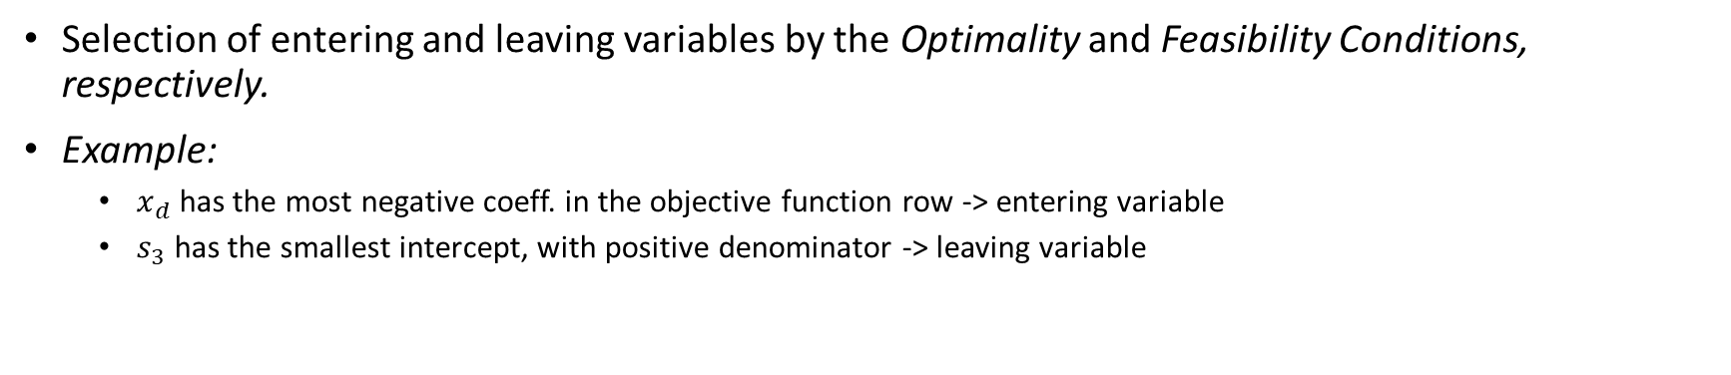
Initial Basic Solution – Enter & Leaving Selections
Selection of entering and leaving variables by the Optimality and Feasibility Conditions, respectively.
Example:
$x_{d}$ has the most negative coeff. in the objective function row -> entering variable
$s_{3}$ has the smallest intercept, with positive denominator -> leaving variable
Entering Column
Basic | z | x_{e} | x_{d} | s₁ | s₂ | s₃ | s₄ | Solution | x_{d} Intercept (ratio)
z | 1 | -0.39 | -0.76 | 0 | 0 | 0 | 0 | - | intercept (ratio)
s₁ | 0 | 2 | 2 | 1 | 0 | 0 | 0 | 43,200 | $\frac{43,200}{2}$ = 21,600
s₂ | 0 | 3.5 | 3.5 | 0 | 1 | 0 | 0 | 29,700 | $\frac{29,700}{3.5}$ = 8,485.7
s₃ | 0 | 1.25 | 8.75 | 0 | 0 | 1 | 0 | 46,800 | $\frac{46,800}{8.75}$ = 5.348.6
s₄ | 0 | 8 | 10 | 0 | 0 | 0 | 1 | 64,800 | $\frac{64,800}{10}$ = 6,480
Pivot Equation
Pivot Element
*Nonbasic variables in blue.

Slide 10

Gauss-Jordan Elimination Method
Pivot Equation
$$new pivot equation=old pivot equation ÷pivot element$$
All Other Equations
$$new eqn=\left(old eqn\right)−\left(its entering column coeff\right) ∙(new pivot eqn)$$

Slide 11






Computing New Pivot Equation
Using previously defined pivot element: 8.75
Basic | z | x_{e} | x_{d} | s₁ | s₂ | s₃ | s₄ | Solution
z
s₁
s₂
x_{d} | 0 | 0.143 | 1 | 0 | 0 | 0.114 | 0 | 5,348.6
s₄
$$\frac{0}{8.75}=0$$
$$\frac{8.75}{8.75}=1$$
$$\frac{0}{8.75}=0$$
$$\frac{0}{8.75}=0$$
$$\frac{1.25}{8.75}=0.143$$
$$\frac{0}{8.75}=0$$
$$\frac{1}{8.75}=0.114$$
$$\frac{46,800}{8.75}=5,348.6$$

Slide 12







Computing New s₄ Equation
Below shows the computation of the new equation (row) for s₄
Initial Basic Solution
Basic | z | x_{e} | x_{d} | s₁ | s₂ | s₃ | s₄ | Solution
z | 1 | -0.39 | -0.76 | 0 | 0 | 0 | 0 | -
s₁ | 0 | 2 | 2 | 1 | 0 | 0 | 0 | 43,200
s₂ | 0 | 3.5 | 3.5 | 0 | 1 | 0 | 0 | 29,700
s₃ | 0 | 1.25 | 8.75 | 0 | 0 | 1 | 0 | 46,800
s₄ | 0 | 8 | 10 | 0 | 0 | 0 | 1 | 64,800
Old Equation
Entering Column Coeff.
2nd Basic Solution
Basic | z | x_{e} | x_{d} | s₁ | s₂ | s₃ | s₄ | Solution
z
s₁
s₂
x_{d} | 0 | 0.143 | 1 | 0 | 0 | 0.114 | 0 | 5,348.6
s₄ | 0 | 6.571 | 0 | 0 | 0 | -1.143 | 1 | 11,314.3
New Pivot Equation
New s₄ Equation
$$0−(10)(0)=0$$
$$10−(10)(1)=0$$
$$0−(10)(0)=0$$
$$1−(10)(0)=1$$
$$8−10(0.143)=6.571$$
$$0−(10)(0)=0$$
$$0−\left(10\right)\left(0.114\right)=−1.143$$
$$64,800−(10)(5,348.6)=11,314.3$$

Slide 13

Complete 2nd Basic Solution
Below shows the 2nd basic solution
Current Solution
Optimality Check
The coeff. of $x_{e}$ is negative in the z equation, hence not optimal.
Basic | z | x_{e} | x_{d} | s₁ | s₂ | s₃ | s₄ | Solution
z | 1 | -0.281 | 0 | 0 | 0 | 0.087 | 0 | 4,064.9
s₁ | 0 | 1.714 | 0 | 1 | 0 | -0.229 | 0 | 35,502.9
s₂ | 0 | 3 | 0 | 0 | 1 | -0.4 | 0 | 10,980
x_{d} | 0 | 0.143 | 1 | 0 | 0 | 0.114 | 0 | 5,348.6
s₄ | 0 | 6.571 | 0 | 0 | 0 | -1.143 | 1 | 11,314.3
State of Variables |  |  |  |  |  | Objective Function
x_{e} | x_{d} | s₁ | s₂ | s₃ | s₄
0 | 5,348.6 | 32,502.9 | 10,980 | 0 | 11,314.3 | 4,064.9

Slide 14
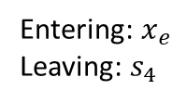
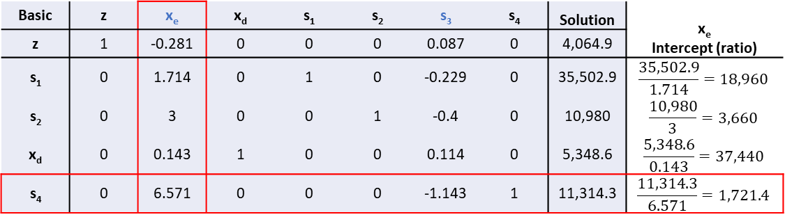
3rd Basic Solution
Gauss-Jordan computations are applied to the 2nd basic solution
Computations yield the table below
Basic | z | x_{e} | x_{d} | s₁ | s₂ | s₃ | s₄ | Solution | x_{e} Intercept (ratio)
z | 1 | -0.281 | 0 | 0 | 0 | 0.087 | 0 | 4,064.9
s₁ | 0 | 1.714 | 0 | 1 | 0 | -0.229 | 0 | 35,502.9 | $$\frac{35,502.9}{1.714}=18,960$$
s₂ | 0 | 3 | 0 | 0 | 1 | -0.4 | 0 | 10,980 | $$\frac{10,980}{3}=3,660$$
x_{d} | 0 | 0.143 | 1 | 0 | 0 | 0.114 | 0 | 5,348.6 | $$\frac{5,348.6}{0.143}=37,440$$
s₄ | 0 | 6.571 | 0 | 0 | 0 | -1.143 | 1 | 11,314.3 | $$\frac{11,314.3}{6.571}=1,721.4$$
Entering: $x_{e}$
Leaving: $s_{4}$
*Nonbasic variables in blue.
Basic | z | x_{e} | x_{d} | s₁ | s₂ | s₃ | s₄ | Solution
z | 1 | 0 | 0 | 0 | 0 | 0.038 | 0.043 | 4,549.5
s₁ | 0 | 0 | 0 | 1 | 0 | 0.070 | -0.261 | 29,551.3
s₂ | 0 | 0 | 0 | 0 | 1 | 0.122 | -0.457 | 5,814.8
x_{d} | 0 | 0 | 1 | 0 | 0 | 0.139 | -0.022 | 5,102.6
x_{e} | 0 | 1 | 0 | 0 | 0 | -0.174 | 0.152 | 1,721.7

Slide 15
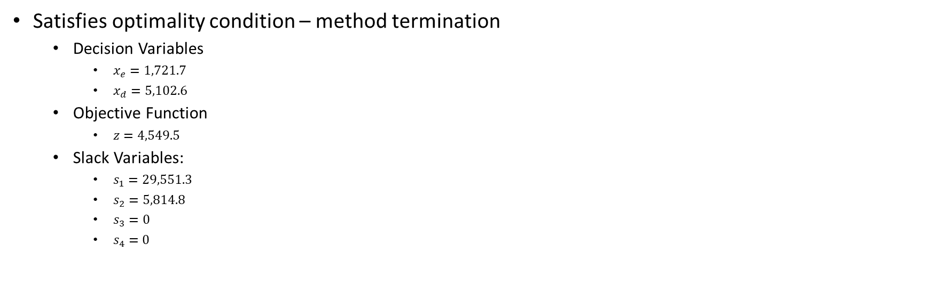
3rd Basic Solution - Interpretation
Basic | z | x_{e} | x_{d} | s₁ | s₂ | s₃ | s₄ | Solution
z | 1 | 0 | 0 | 0 | 0 | 0.038 | 0.043 | 4,549.5
s₁ | 0 | 0 | 0 | 1 | 0 | 0.070 | -0.261 | 29,551.3
s₂ | 0 | 0 | 0 | 0 | 1 | 0.122 | -0.457 | 5,814.8
x_{d} | 0 | 0 | 1 | 0 | 0 | 0.139 | -0.022 | 5,102.6
x_{e} | 0 | 1 | 0 | 0 | 0 | -0.174 | 0.152 | 1,721.7
*Nonbasic variables in blue.
Satisfies optimality condition – method termination
Decision Variables
$x_{e}=1,721.7$
$x_{d}=5,102.6$
Objective Function
$z=4,549.5$
Slack Variables:
$s_{1}=29,551.3$
$s_{2}=5,814.8$
$s_{3}=0$
$s_{4}=0$

Slide 16
Connection to Graphical Method
Iterating through basic solutions is like tracing the edges of the feasible region.
(0, 5348.6)
(1721.7, 5102.6)
(0, 0)
(8100, 0)

Slide 17
Reference
Taha, Hamdy A. Operations Research An Introduction: 5th Edition, New York City, Macmillan Publishing Company, 1992.

